Slide 2
Welcome
Elena Rios, MD, MSPH, MACP
President
National Hispanic Health Foundation
Housekeeping
All participant microphones will be muted, but please feel free to use the raised hand feature to be unmuted to ask a question or type your question into the Q & A box for the panelists to address during our Q & A session at the end.
The recording will be housed on NHMAFoundation.org and our YouTube channel.
Post-Webinar questionnaire will be sent to all attendees
The recording and slides will be sent out one week after the event.

Slide 3
Joseph Martel, MD
Assistant Dean of Graduate Medical Education
Chair, Department of Ophthalmology
California Northstate College of Medicine
SoloKiko.org

Slide 4
Clinical Trial Projects for Latinx Physicians

Slide 5
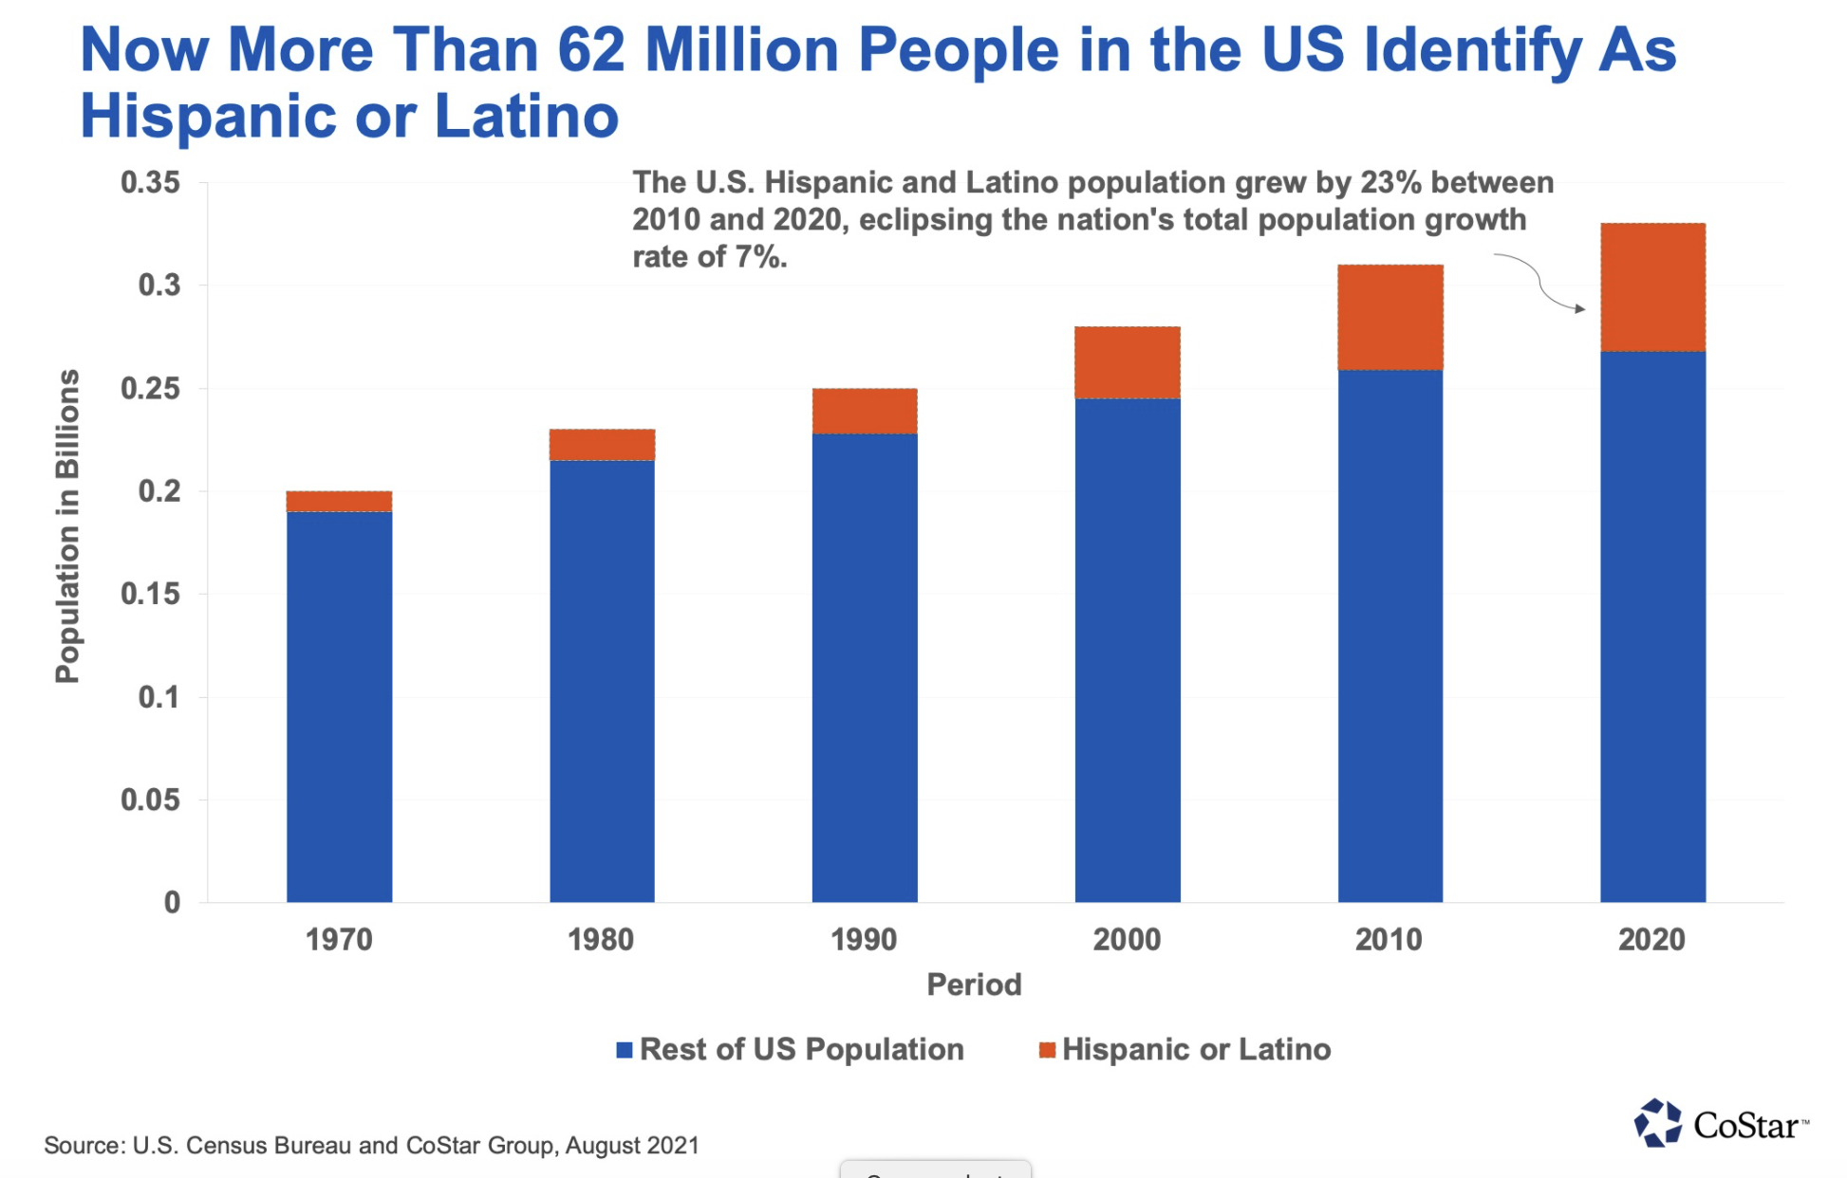
Latinx Population
The largest racial/ethnic minority group in the United States and is projected to continue increasing,
reaching 29% by 2065. In 1980, the Latinx population comprised only 5.4% of the US population. By 1990,
we comprised 9.0%, in 2000 12.5%, and by 2006 14.7%.

Slide 6
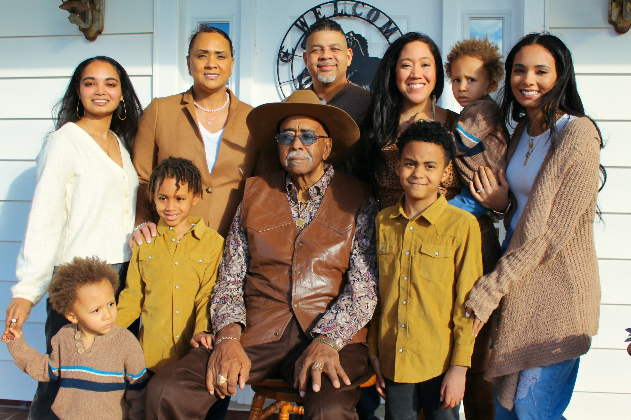
Hispanics will continue to become larger consumers of health care in the US

Slide 7
Latinx under-representation in clinical trials
Minorities have historically been underrepresented in clinical trials.
In 2011, African Americans and Hispanics comprised 12% and 16% of the US population, respectively, but only 5% and 1% of trial participants were African Americans and Hispanics, respectively.

Slide 8
So why are clinical trials so important?

Slide 9
Why is diversity in clinical trials so important?
Example of the Demographics of an approved Diabetic medication:
The diverse enrollment of subjects engaged in clinical trials research is, thus, critical to developing safer and more effective drugs and medical devices.
According to a review of 167 new molecular entities approved by the Food and Drug Administration (FDA) between 2008 and 2013, approximately 1 in 5 had differences in exposure, response across racial or ethnic. groups

Slide 10
Barriers to Diversity

Slide 11
Latinx Physicians are uniquely position to address this problem
Serve Latinx community
Culturally sensitive and competent
Generally, speak both English and Spanish
Have the trust of the community
Understand their patients needs
Frequently have family members afflicted by these illnesses

Slide 12
Latinx Physicians can Improve Diversity
Make a commitment to improve diversity in your clinical trials
CREATE A RESEARCH DEDICATED TEAM IN YOUR OFFICE
Identify barriers to recruitment and enrollment- ask the patients and staff what barriers they perceive
Develop cultural competence in yourself and your staff
a. referring physicians
b. Investigators
c. Study coordinators
Acquire the necessary documents to conduct clinical trials with bilingual communities
Develop a recruitment/enrollment program that will optimize diversity in your clinical trials based on your practice

Slide 13
Some Pearls
Latinx physicians are uniquely positioned to improve diversity so consider doing clinical trials
Often Clinical Sponsoring companies do not automatically include translation of research material to include Spanish. Once this issue is raised “in writing” they almost universally comply
Hispanic patients without a social security are often reluctant to participate because they are afraid of being reported to the government because of the 1099 tax form. This is not a significant issue if patient stipend is under $600 and no 1099 is required
You can do a lot of good, and it can increase significantly your practice income

Slide 14
..Our Team

Slide 15
Drug Development
Edward Mena., MD FAASLD,MBA
CEO of California Liver Research Institute (CLRI)
Pasadena Liver Center (PLC)

Slide 16
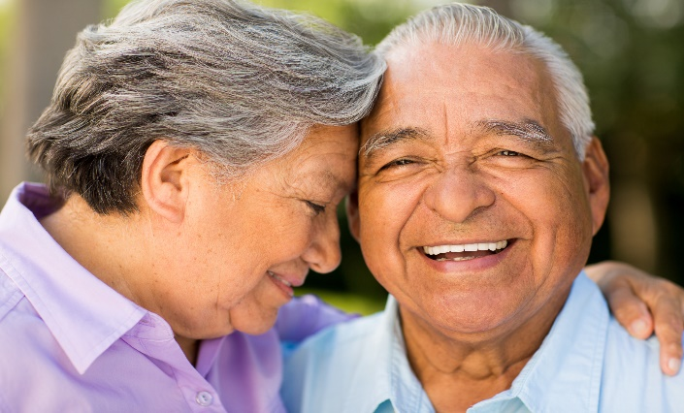
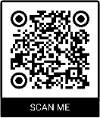
Hispanics are now the highest group in the US at risk for liver cancer. WHY?
In Hispanics, liver cancer is 2x as likely vs. non-Hispanic whites.
Nearly 50% of Hispanics live with Fatty liver disease —NAFLD— is caused by a combination of obesity, diabetes.
Hispanics are 2x as likely to develop type 2 diabetes vs. non-Hispanic whites.
Sign up to learn more at a future, free online LIVE event delivered by a Physician Expert.

Slide 18
Phase 1
Purpose: Safety and Dosage
Phase I studies are done to find the highest dose of the new treatment that can be given safely without causing severe side effects
The drug will be tested in a small group of 15 to 30 patients healthy volunteers or people with the disease/condition participate in Phase 1
looking at what the drug does to the body and what the body does with the drug
Placebos (inactive treatments) are not used in phase I trials

Slide 19
Phase II
Purpose: Efficacy and Side effects
researchers administer the drug to a large group of patients with the disease or condition for which the drug is being developed
researchers answer research questions related to
how it works in the body
the side effects associated with increased dosage
early information about how effective it is to determine how best to administer the drug to limit risks and maximize possible benefits
Phase 2a is focused specifically on dosing requirements
Phase 2b trials are designed specifically to rigorously test the efficacy of the drug in terms of how successful it is in treating, preventing or diagnosing a disease
Notes:
PHASE 2A: A small number of patients are administered the drug in different quantities to evaluate whether there is as a dose-response relationship, which is an increase in response that correlates with increasing increments of dose. In addition, the optimal frequency of dose is also explored.

Slide 20
Phase III
Purpose: Efficacy and Monitoring of Adverse Reactions
design Phase 3 studies to demonstrate whether or not a product offers a treatment benefit to a specific population
known as pivotal studies, involve 300 to 3,000 participants
Often, these trials are randomized
means that patients are put into a treatment group, called trial arms, by chance. Randomization is needed to make sure that the people in all trial arms are alike
Phase 3a
To get sufficient and significant data
Phase 3b
Allows patients to continue the treatment

Slide 21
FDA Approval
when phase III clinical trials (or sometimes phase II trials) show a new drug is more effective or safer than the current treatment, a new drug application (NDA) is submitted to the Food and Drug Administration (FDA) for approval
Based on the review, the FDA decides whether to approve the treatment for use in patients with the illness the drug was tested on
If approved:
the new treatment often becomes a standard of care and newer drugs may be tested against it before they can be approved
If the FDA feels that more evidence is needed to show that the new treatment's benefits outweigh its risks, it may ask for more information or even require that more studies be done.

Slide 22
Phase IV
Purpose: Safety and Efficacy
Phase 4 trials are carried out once the drug or device has been approved by FDA during the Post-Market Safety Monitoring
Phase IV studies look at drugs that have already been approved by the FDA. The drugs are available for doctors to prescribe for patients
The drug is tested in several hundreds or thousands of patients
Phase IV studies look at safety over time

Slide 23
How do you start the Infrastructure
The goal needs to be which disease state you plan to study
What phases of clinical trial development are you interested in studying
You will need to start with a Research Coordinator, research assistant and budget coordinator.
The structure of your organization
Nonprofit 501C3
For profit LLC
What type of IRB (Institutional Review Board) do you plan to work with
Central
Local IRB at your current institutions

Slide 24
How to connect to larger system Trials
Join a Consortium
Research networks
Meet with MSL (Medical Science Liaison) of the company and disease state. Connect with the company doing the research
Gilead, Novartis, BMS, Pfizer, etc.
Talk with other physician conducting clinical trials in the same disease state.
The questions that all pharma would like to know is how quickly can you start the clinical trial and how do you plan on enrolling patients.
From your personal clinic? Hospital or group practice?

Slide 25
How do you recruit Hispanic patients and retention
The key is trust.
Knowing that you have their best interest in mind
These studies are highly regulated by the FDA
Lose the fear of clinical trials
Guinea pig scenario
Fear of being at big medical centers
Discuss safety and efficacy
The importance of studying disease effects on our specific population
Hepatitis C and NASH
NASH genetic predisposition
Education to our providers on the importance of Clinical trials and drug development
Cost of Clinical trials
free
Transportation
Site will provide transportation

Slide 26
How did I get training
I did research through most of my career
Trial and experience and jumping into clinical trials and opening a clinical trial center
Mentorship
Working with physician and peers who have done clinical trials
Networking and Consortiums
NHMA has research network - on Hispanic research
NHMA setting up conferences and networking capabilities among Latino physicians doing clinical trials
Expanding young physicians in participating in clinicall trials

Slide 27
Pharma
Pharma is always willing to partner with active a successful sites
More willing to partner with non-academic centers to speed the enrollment process by using a Central IRB
Once successful the pharma will continue to use your site for all future and upcoming studies.
They help with equipment, training of staff, etc.

Slide 28
CLRI studies
Studies | Phase
Galmed NASH F2/3- (150 pts) | 3
Assembly Hepatitis B E antigen positive and negative TN, or +Viremia | 2a
Novartis NASH F2/3 | 2b
Galectin cirrhosis | 2b/3
Celgene F3 | 2
Gilead 5443 PSC | 2
Gilead 4194 PSC | 3
Viking NASH F2/3 | 2b
Pfizer NASH F2/3 | 2
Pliant PSC | 2a

Slide 29
Research Hound
App designed to connect patient to clinical trial centers across the country

Slide 30
Thank you

Slide 31
NHHF Updates
Clinical Trial Mentorship Opportunity
If interested in becoming a mentor/mentee, please email us: nhhf@nhmafoundation.org
Post-webinar Questionnaire
Please support and submit
2022 Annual Hispanic Health Professional Student Scholarship Gala
If interested in Sponsorship opportunities please email us at nhhf@nhmafoundation.org
Deadline to sponsor is Friday, September 23rd, 2022.

Slide 32
NHHF Updates
Community Access Grant: Final Call
Deadline is September 4
Check out our Rockefeller Solo Kiko COVID-19 program
Fill out the survey for a chance to be entered into our raffle!
If you have any questions about our programs or events, please email nhhf@nhmafoundation.org

Slide 33
Thank You!

